Slide 1

Demonstration on SALES CONFIGURATOR
for
Version#3
CAMINAR ENGINEERING

Slide 2
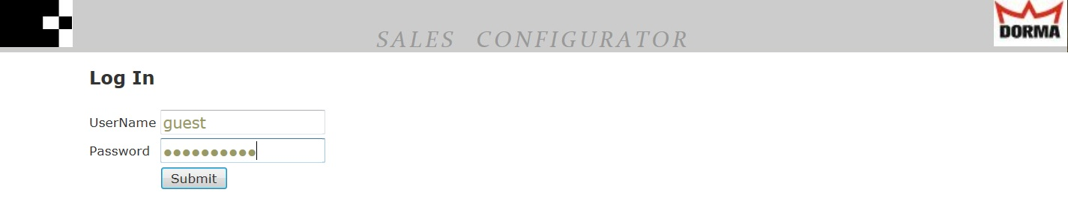
loginpage
Features
Username.
Password.
Please note the credentials will be provided later

Slide 3
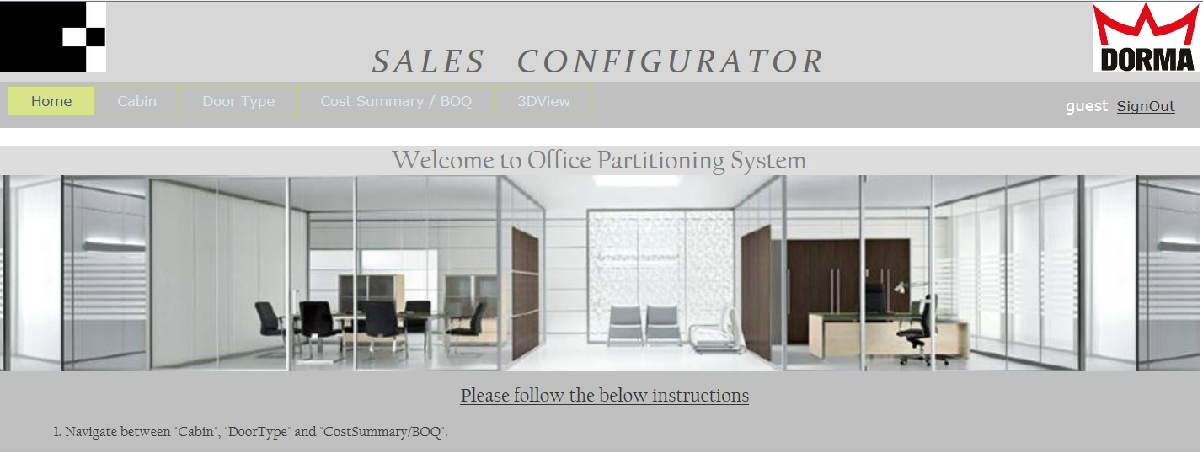
Homepage
Features
Major Tabs
Cabin
Door Type
Cost Summary/BOQ
3D View
Login user
Sign out
Facts
Major Tabs/ pages are independent to each other. The user can pick a “Door Type” without picking “Cabin”

Slide 4
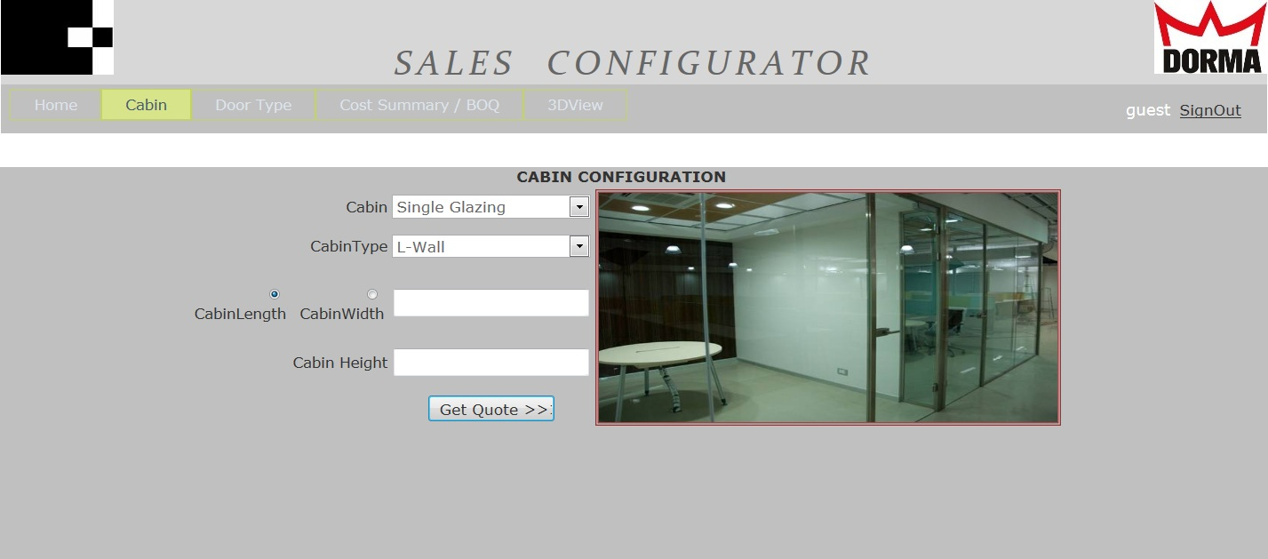
cabin
Inputs
Cabin
Cabin Type
Cabin Length or
Cabin Width
Cabin Height
Facts
Intelligence to perform dynamic filter based on user input. i.e. “Door Opening Options” will be automatically filtered based on user selection in
“Get Quote” brings the data to Cost Summary/BOQ page in a readable format.

Slide 5
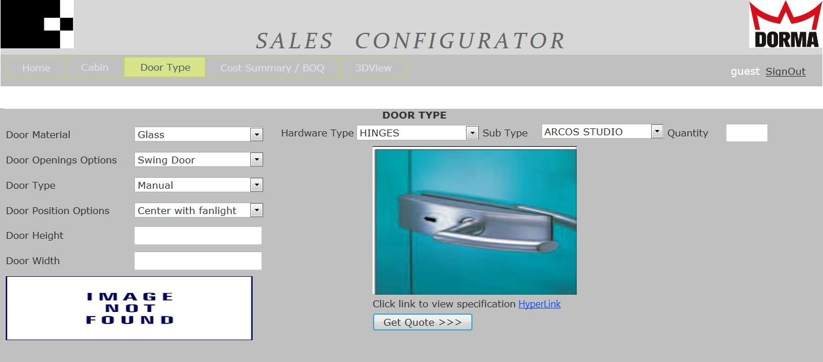
DOOR TYPE
INPUTS-1
Door Material
Door Opening Options
Door Type
Door Position Options
Door Height
Door Width
INPUTS-2
Hardware Type
Hardware Sub Type
Quantity
Facts
Intelligence to perform dynamic filter based on user input. i.e. “Door Opening Options” will be automatically filtered based on user selection in “Door Material” .
“Get Quote” brings the data to Cost Summary/BOQ page in a readable
format.
Spec viewable in PDF format

Slide 6
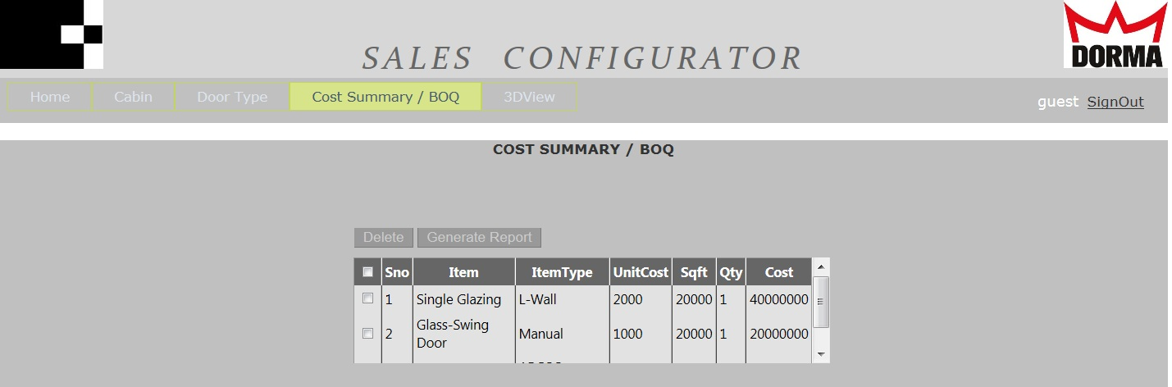
COST SUMMARY/BOQ
INPUTS
User click on “Cost Summary/BOQ”major tab.
Delete
Generate Report
Check
Facts
Intelligence to calculate Cabin Cost, Door hardware cost based on selection made in “Cabin” and “Door Type”
Intelligence to add the quantity and cost of an item if it already exists in the summary table.
User can delete a row of information by clicking a “Check box”
User can generate a report in text format(for now).
Scroll bar will be available to the user fatigueless.

Slide 7
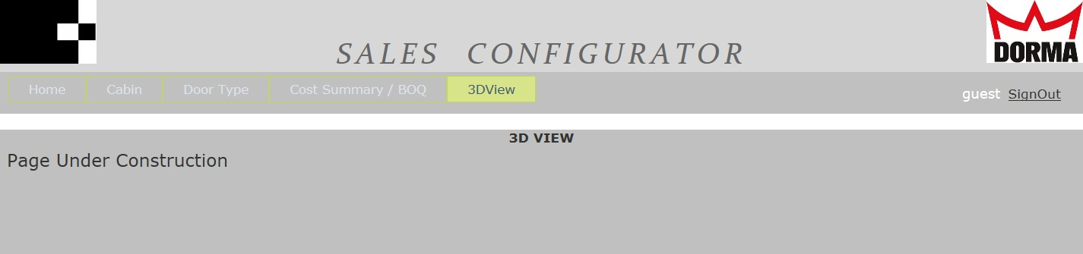
3DVIEW
Facts
To be completed based on master models created.

